Slide 1
Material hardening law
Hansel & Spittel – Fast Identification Algorithm

Slide 2
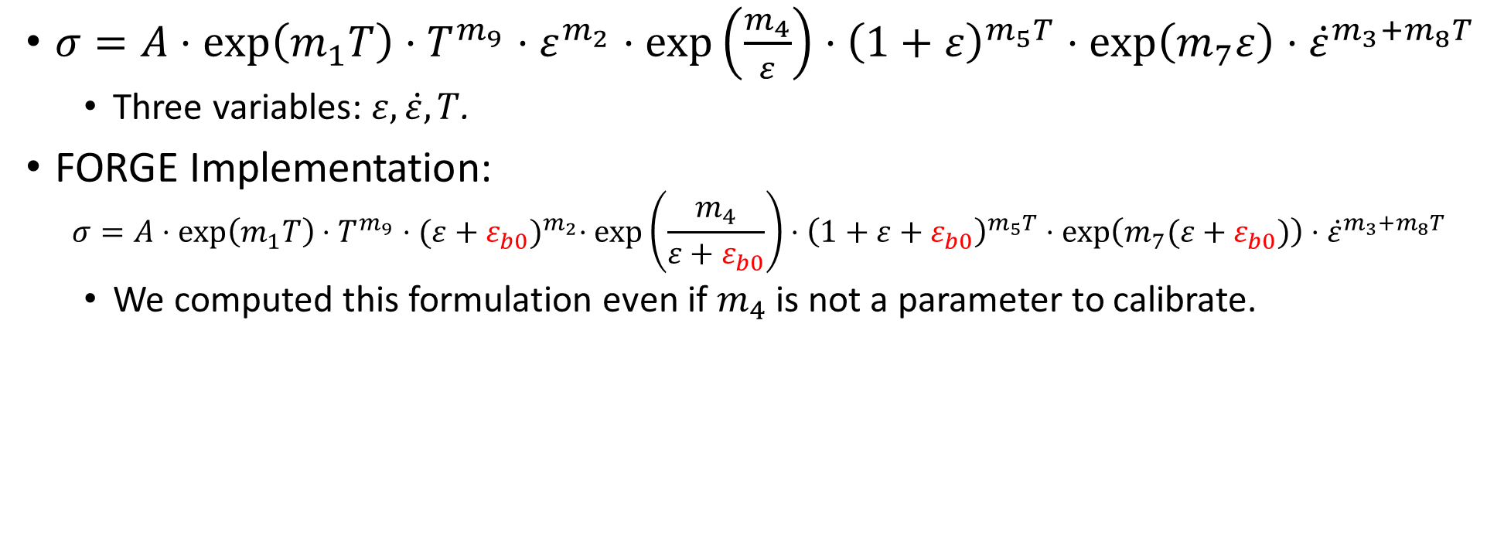
Hansel & Spittel (H&S)
$σ=A⋅\exp\left(m_{1}T\right)⋅T^{m_{9}}⋅ε^{m_{2}}⋅\exp\left(\frac{m_{4}}{ε}\right)⋅{\left(1+ε\right)}^{m_{5}T}⋅\exp\left(m_{7}ε\right)⋅{\dot{ε}}^{m_{3}+m_{8}T}$
Three variables: $ε, \dot{ε}, T$.
FORGE Implementation:
$$σ=A⋅\exp\left(m_{1}T\right)⋅T^{m_{9}}⋅{(ε+ε_{b0})}^{m_{2}}⋅\exp\left(\frac{m_{4}}{ε+ε_{b0}}\right)⋅{\left(1+ε+ε_{b0}\right)}^{m_{5}T}⋅\exp\left(m_{7}(ε+ε_{b0})\right)⋅{\dot{ε}}^{m_{3}+m_{8}T}$$
We computed this formulation even if $m_{4}$ is not a parameter to calibrate.
Notes:
The two will be plotted.

Slide 3
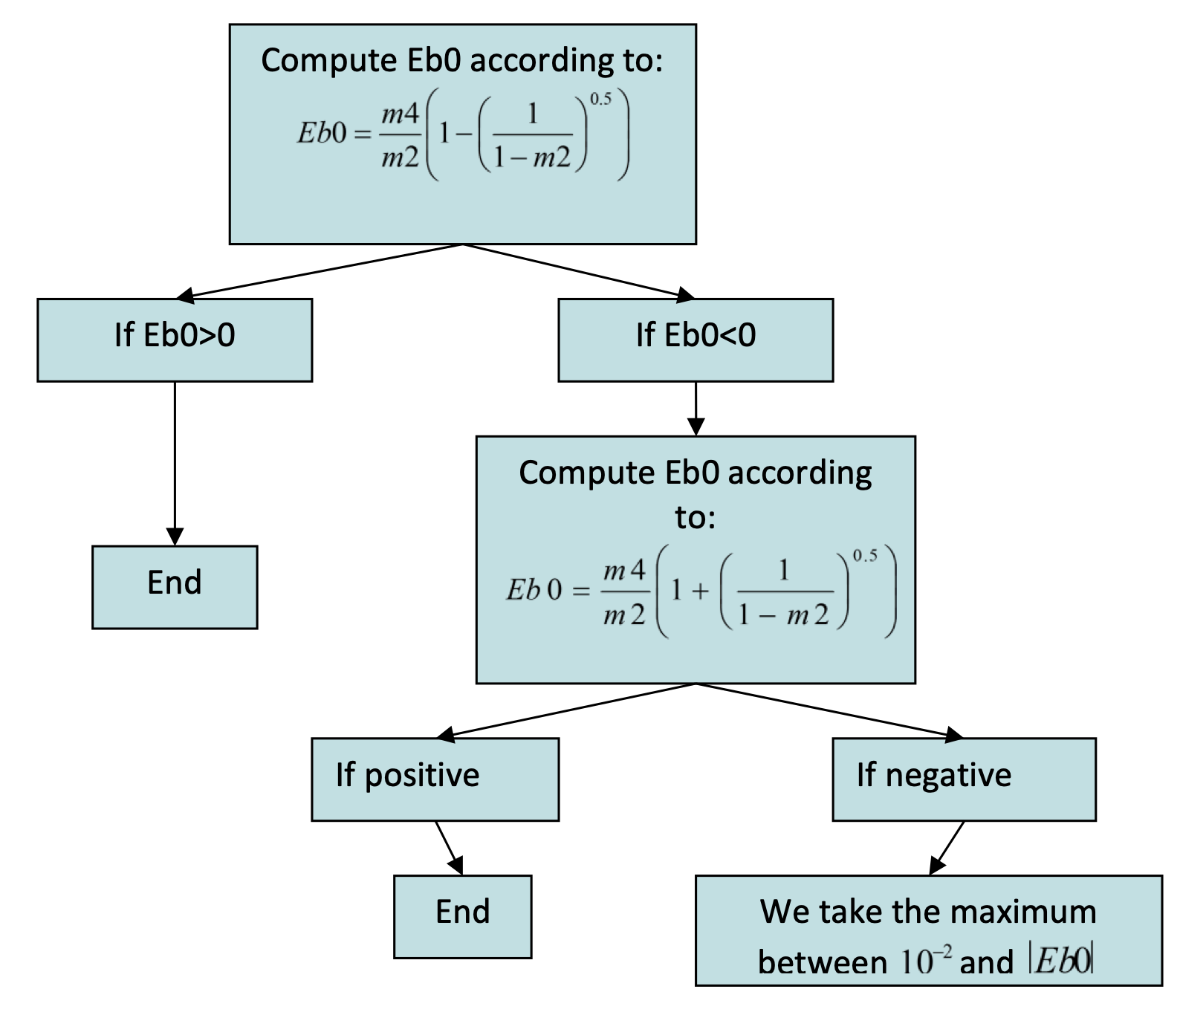
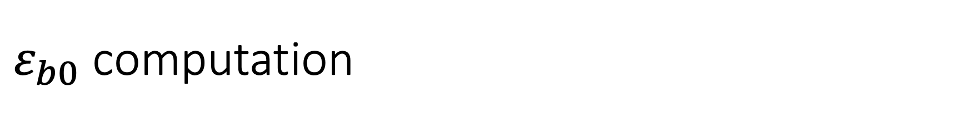
$ε_{b0}$ computation
Source: FORGE pdf documentation. Part 5 – Process data.

Slide 4
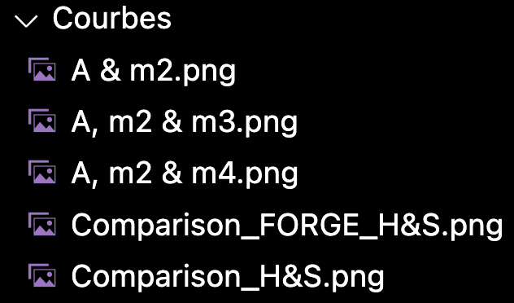
Algorithm development
Based on scipy.optimize.curve_fit.
Input:
Parameters.
Configurations:
Output: Folder with:
Each configuration.
A comparison between all the configurations.
Configurations to plot

Slide 5
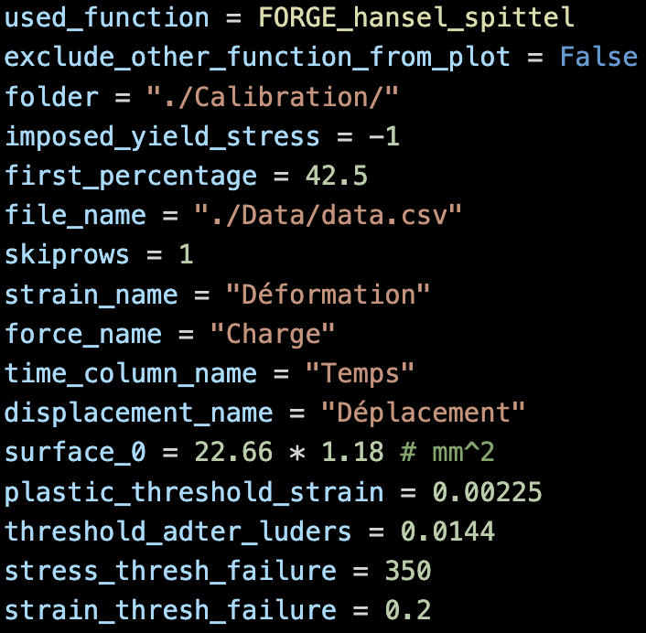
Parameters
Mandatory parameters
Set them again at each law identification.
If they are badly set, the program will return bad curves.
You can use two different formulations of the H&S law : the original hansel_spittel or the modified FORGE version FORGE_hansel_spittel. This latter is recommended if you use this software. You can exclude the other formulation from plots.
Saving folder name (will be created automatically)
Only available with FORGE_hansel_spittel function and with exactly A & m2 parameters. Extents in future versions. If < 0: not imposed. If >= 0: imposed (replace -1 by the desired value of the yield stress).
The first percentages of the data that will be used for curve fitting.
Data file (csv) with ; as separator.
Number of rows to skip in the csv data file
Strain column name
Force column name (used for stress calculation) in Newton.
Time column name
Displacement column name
Section of the specimen (used for stress calculation) in mm^2.
Next slide

Slide 6
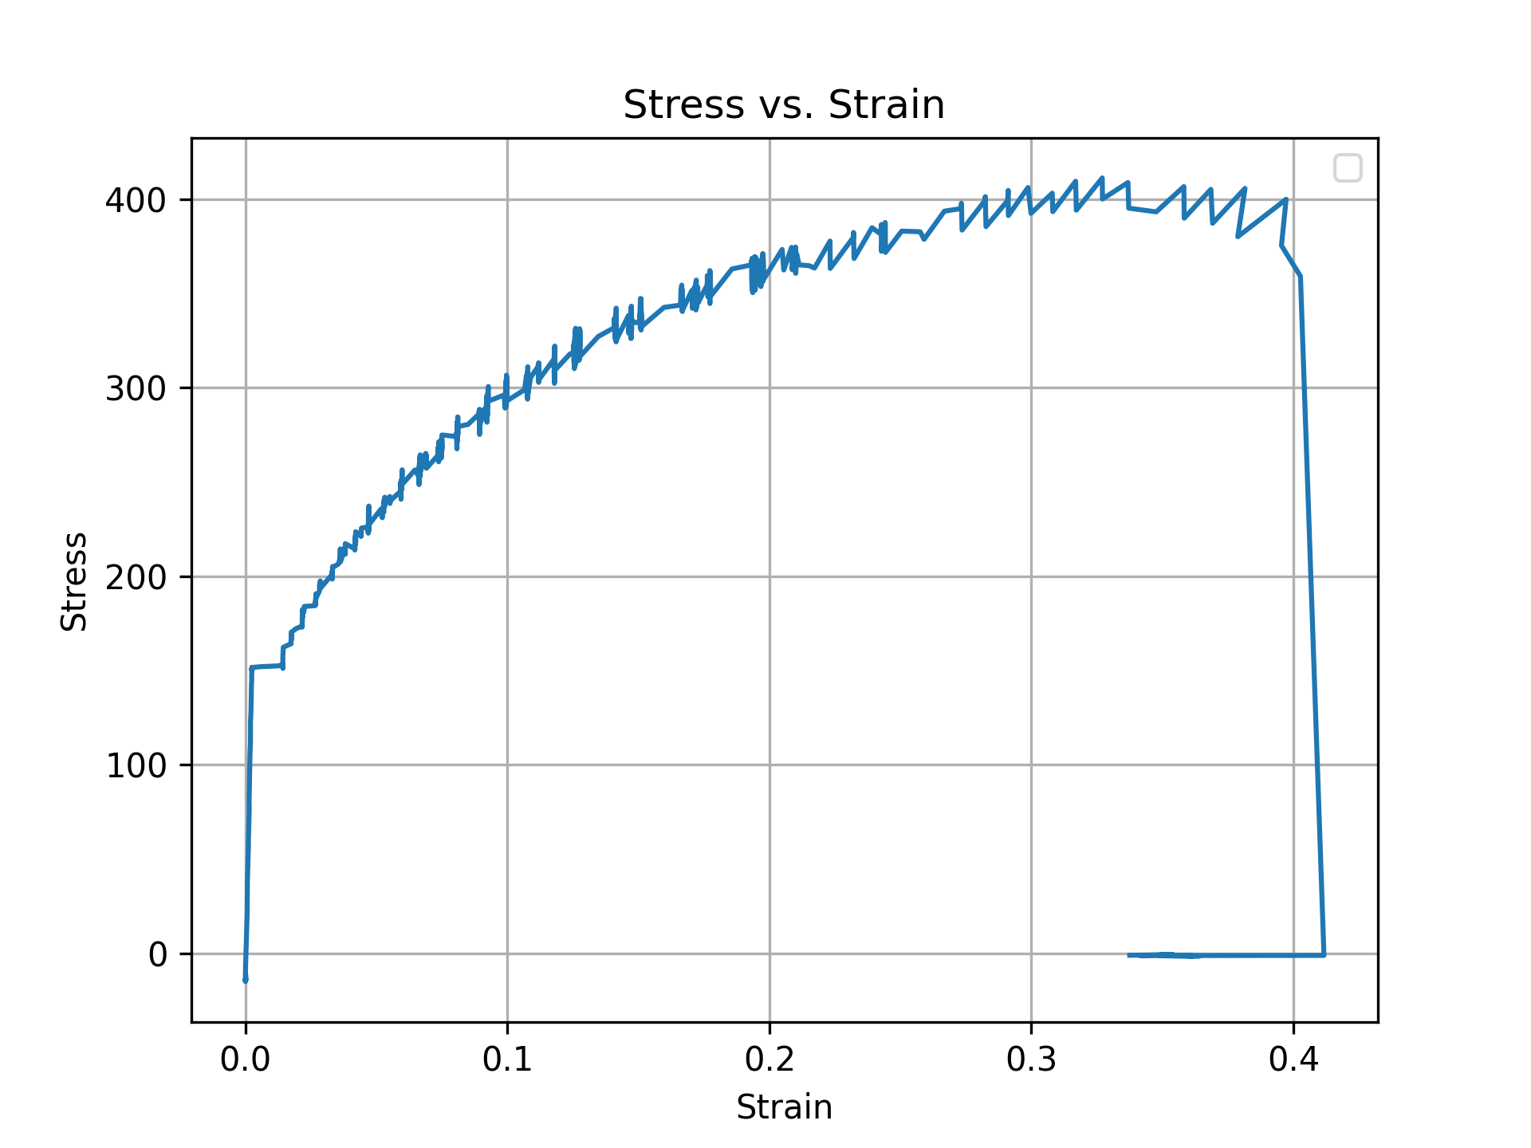
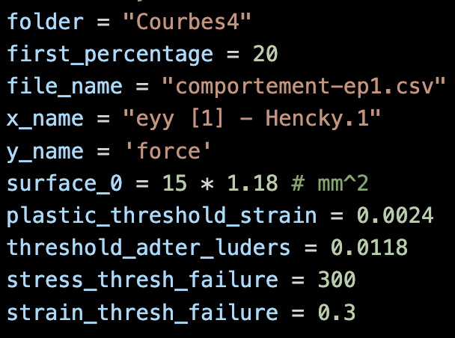
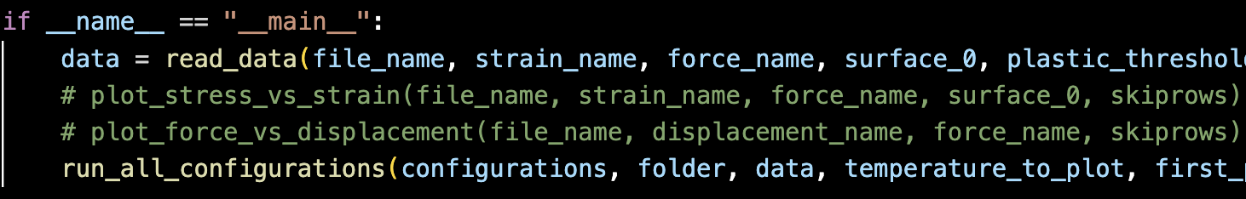
Parameters
Mandatory parameters
Parameters 3 & 4 are only used to select the first given percentages of the curve. They should be removed in a future version.
In order to plot the Stress vs. Strain curve, you can uncomment the first commented line in the IF loop. It is also possible to plot the Force vs. Displacement curve.
1
3
2
Lüders
3
4
Zone to get rid of (approximative)
1
2
4

Slide 7
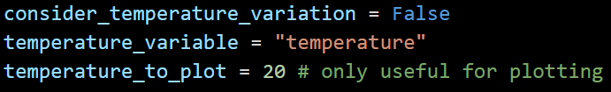
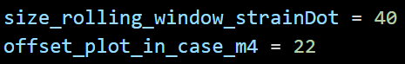
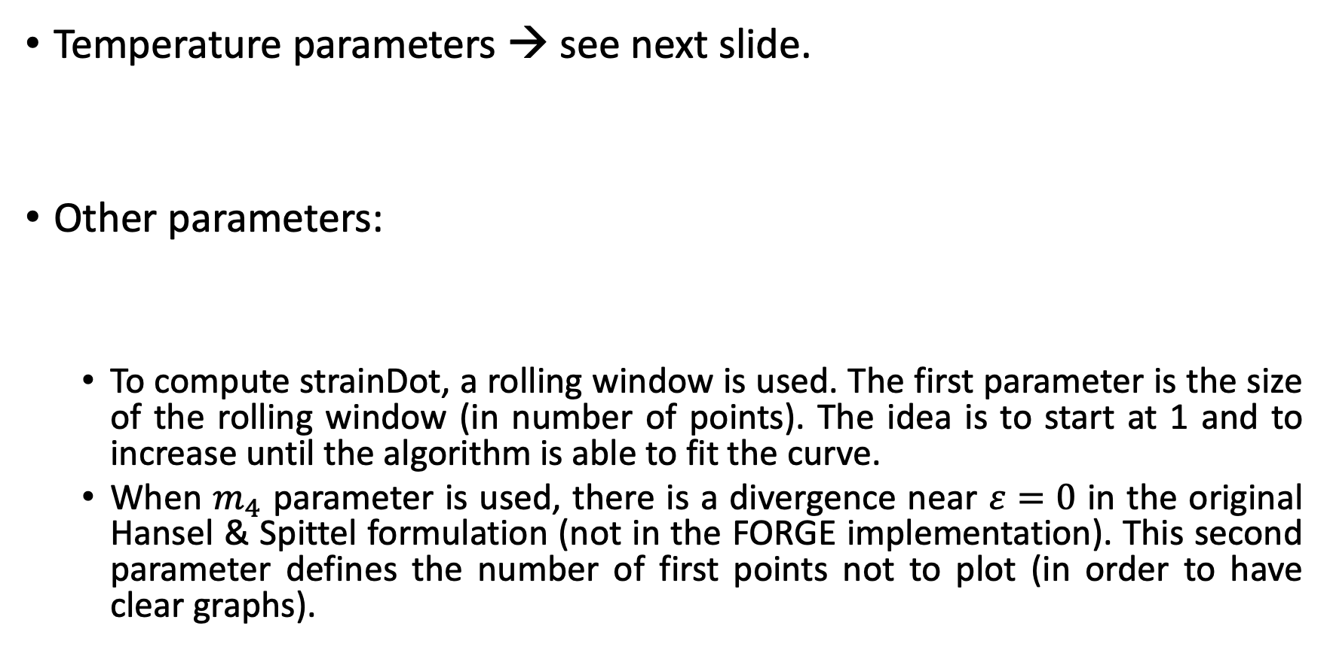
Parameters
Temperature parameters → see next slide.
Other parameters:
To compute strainDot, a rolling window is used. The first parameter is the size of the rolling window (in number of points). The idea is to start at 1 and to increase until the algorithm is able to fit the curve.
When $m_{4}$ parameter is used, there is a divergence near $ε=0$ in the original Hansel & Spittel formulation (not in the FORGE implementation). This second parameter defines the number of first points not to plot (in order to have clear graphs).

Slide 8
Remarks
If you do not add the parameter « A » in the parameters to calibrate, we do not guarantee that the program will return correctly, especially if you impose the yield stress.

Slide 9
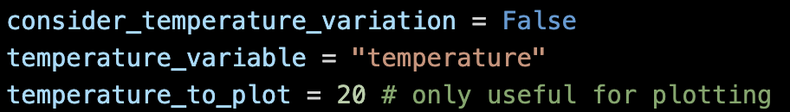
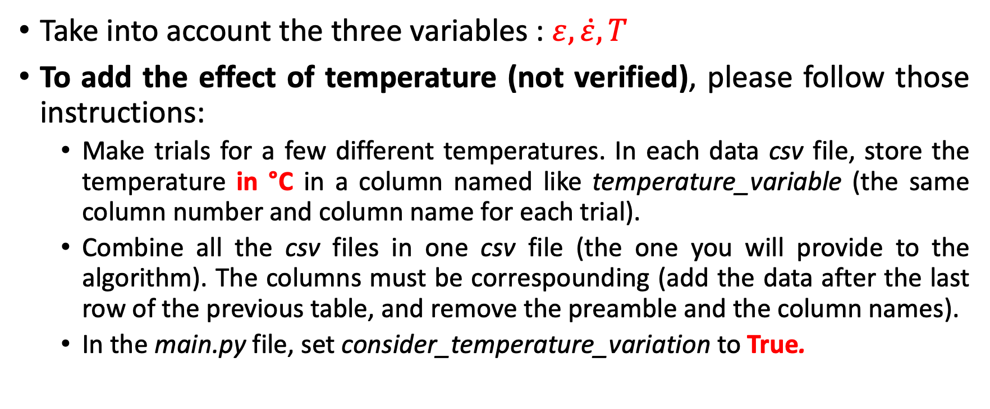
Optimization algorithm
Take into account the three variables : $ε, \dot{ε},T$
To add the effect of temperature (not verified), please follow those instructions:
Make trials for a few different temperatures. In each data csv file, store the temperature in °C in a column named like temperature_variable (the same column number and column name for each trial).
Combine all the csv files in one csv file (the one you will provide to the algorithm). The columns must be correspounding (add the data after the last row of the previous table, and remove the preamble and the column names).
In the main.py file, set consider_temperature_variation to True.
IDEM to add the effect of strainDot.

Slide 10
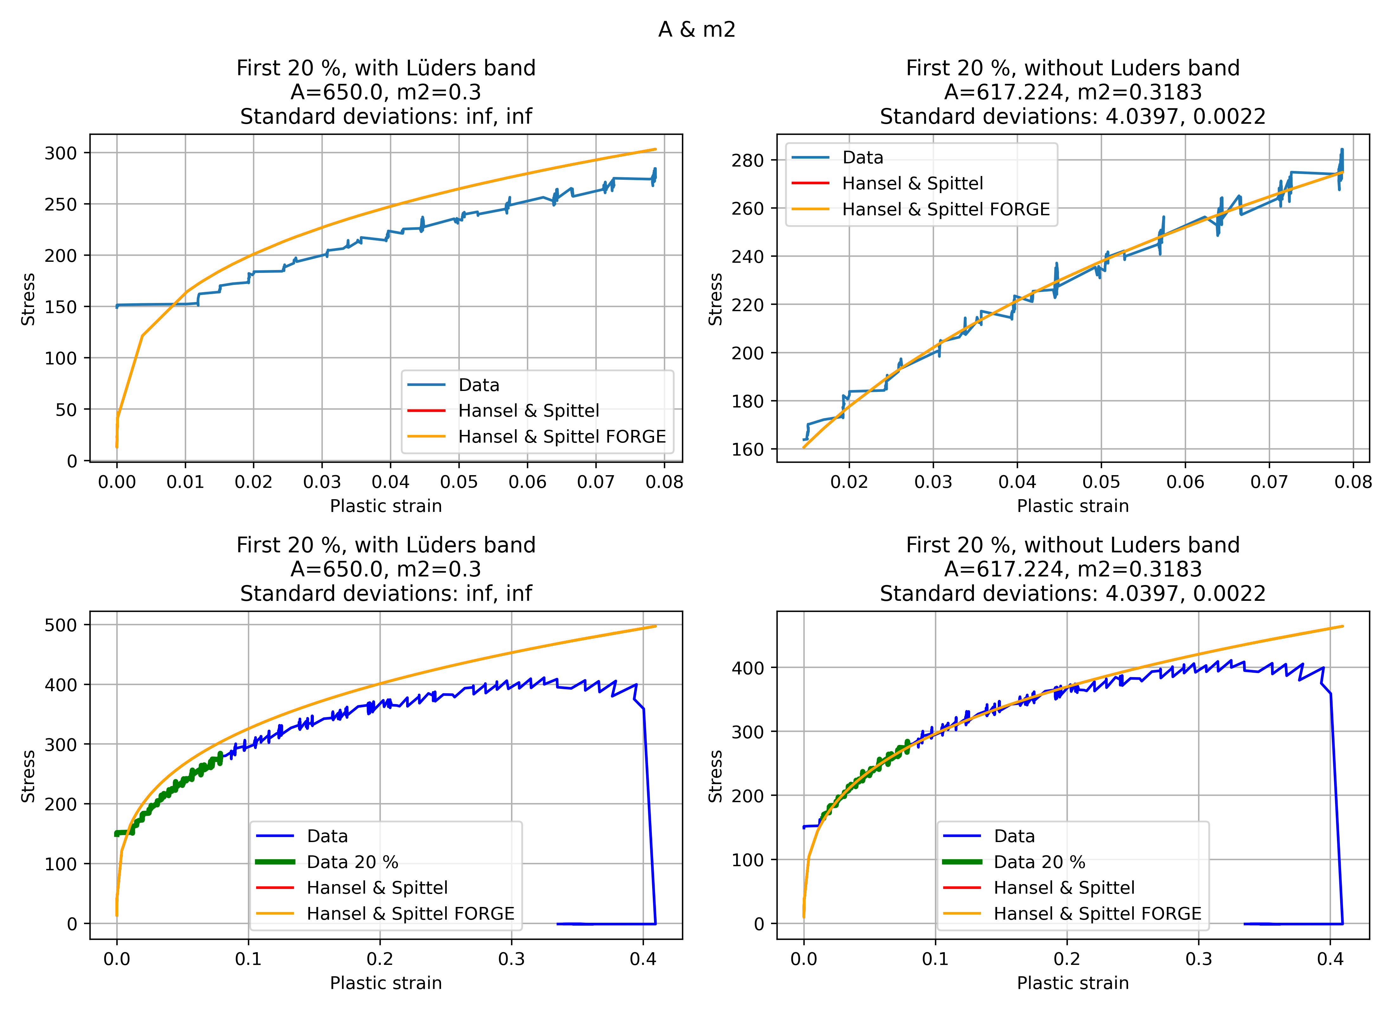
Output Folder: Unique Configuration Plot
Zoom
Global view
With Lüders band
Without Lüders band
Notes:
FORGE and original: same curves.

Slide 11
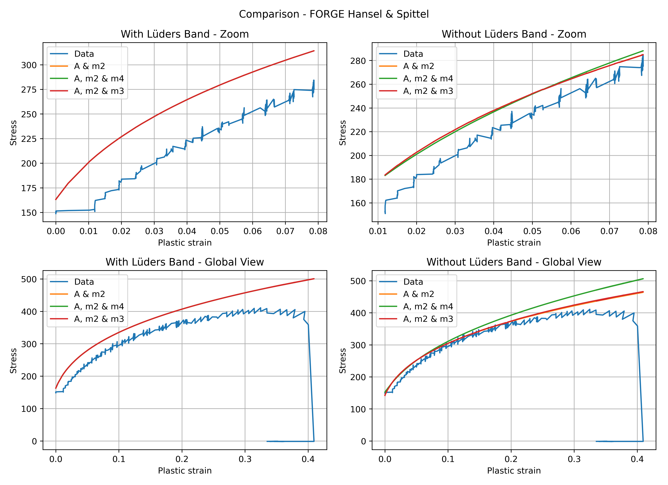
Output Folder: Comparisons (Original & FORGE laws)
Zoom
Global view
With Lüders band
Without Lüders band

Slide 12
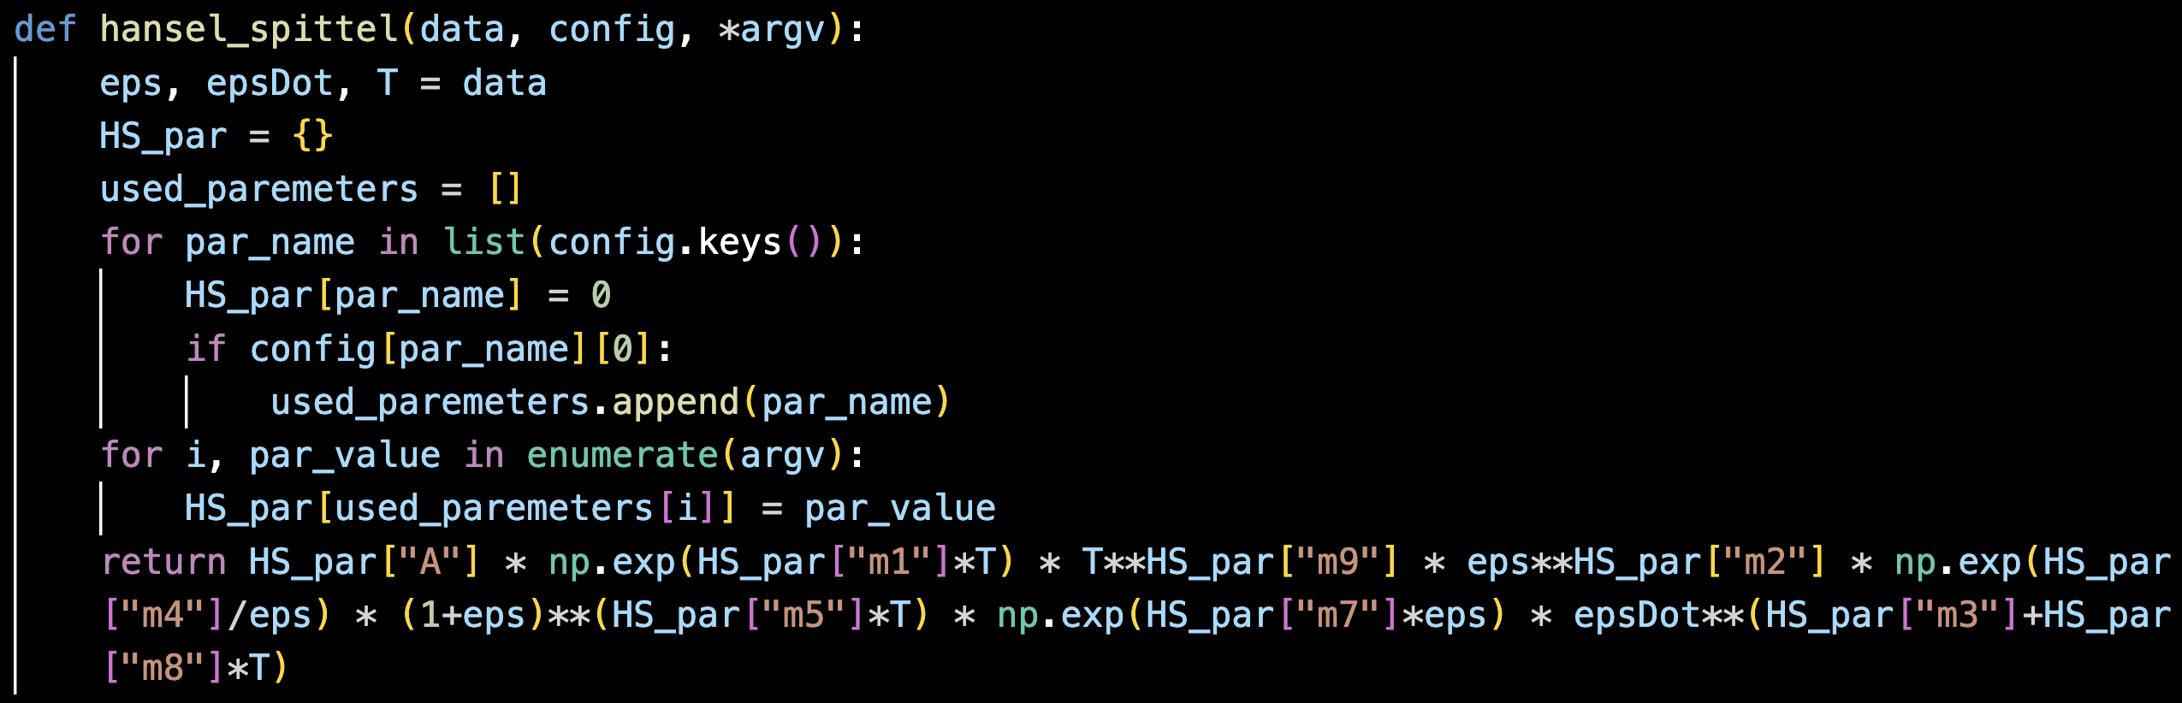
Optimization algorithm
$data=entries=(ε, \dot{ε},T)$ where $ε, \dot{ε},T$ are lists.
Notes:
Optimization done on entries (three lists)

Slide 13
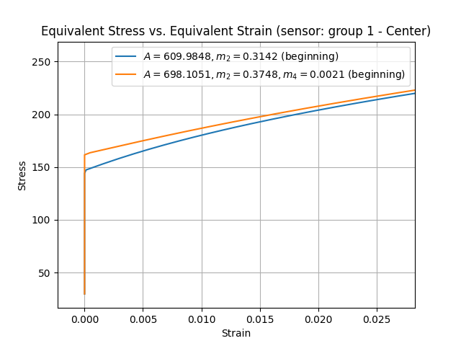
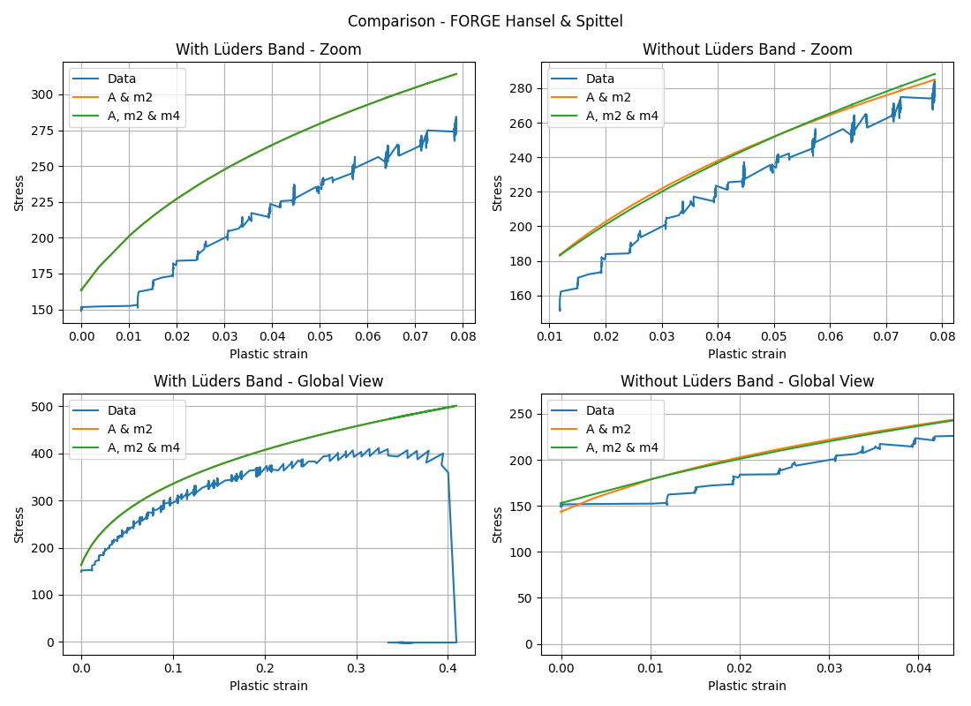
Comparison with real FORGE - beginning
FORGE
ALGORITHM

Slide 14
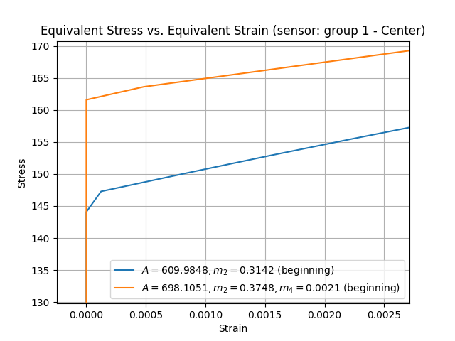
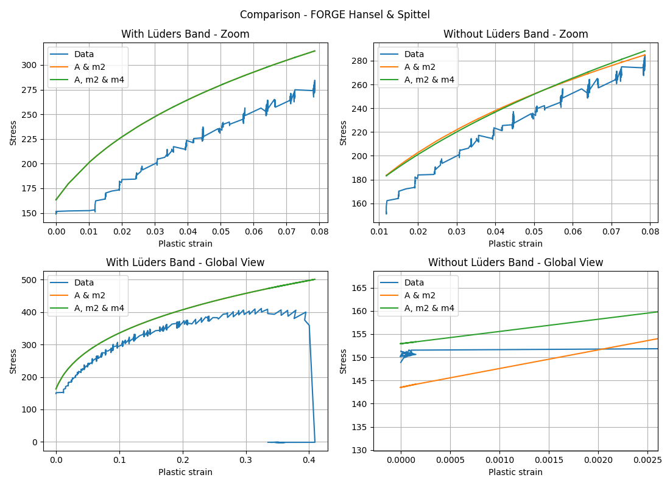
Comparison with real FORGE - beginning
FORGE
ALGORITHM
Conclusion: $ε_{b0}$ compuration satisfying for A & m2, should be improved for more parameters.

Slide 15
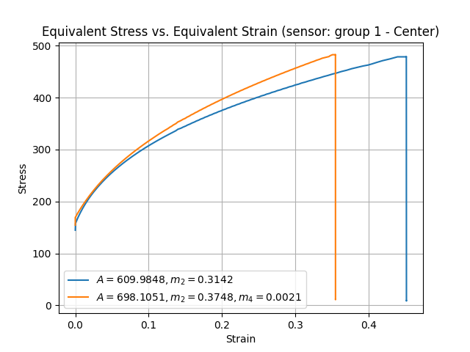
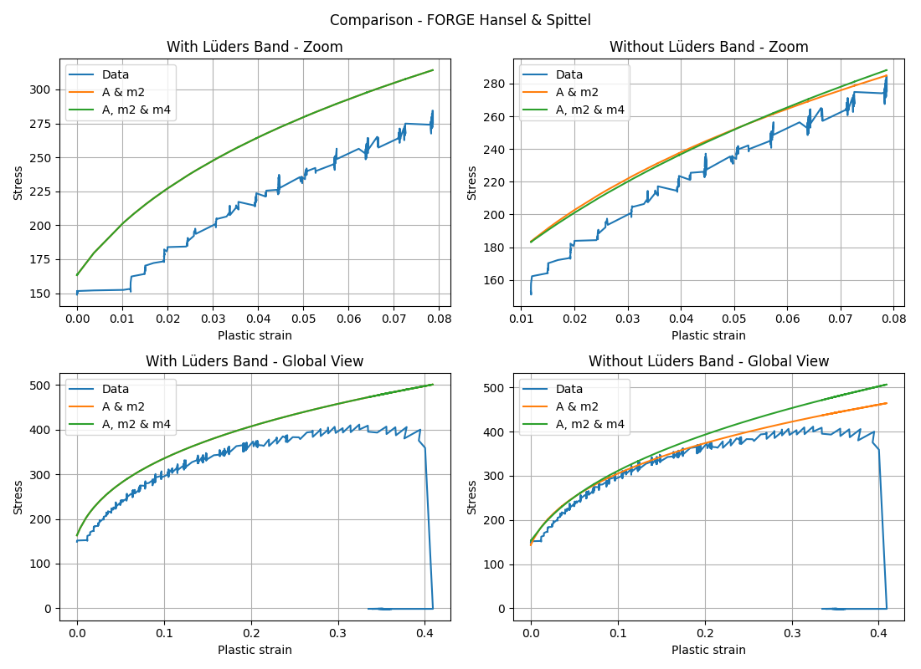
Comparison with real FORGE – global view
FORGE
ALGORITHM
Notes:
Very good → models almost perfectly correspounding.

Slide 16
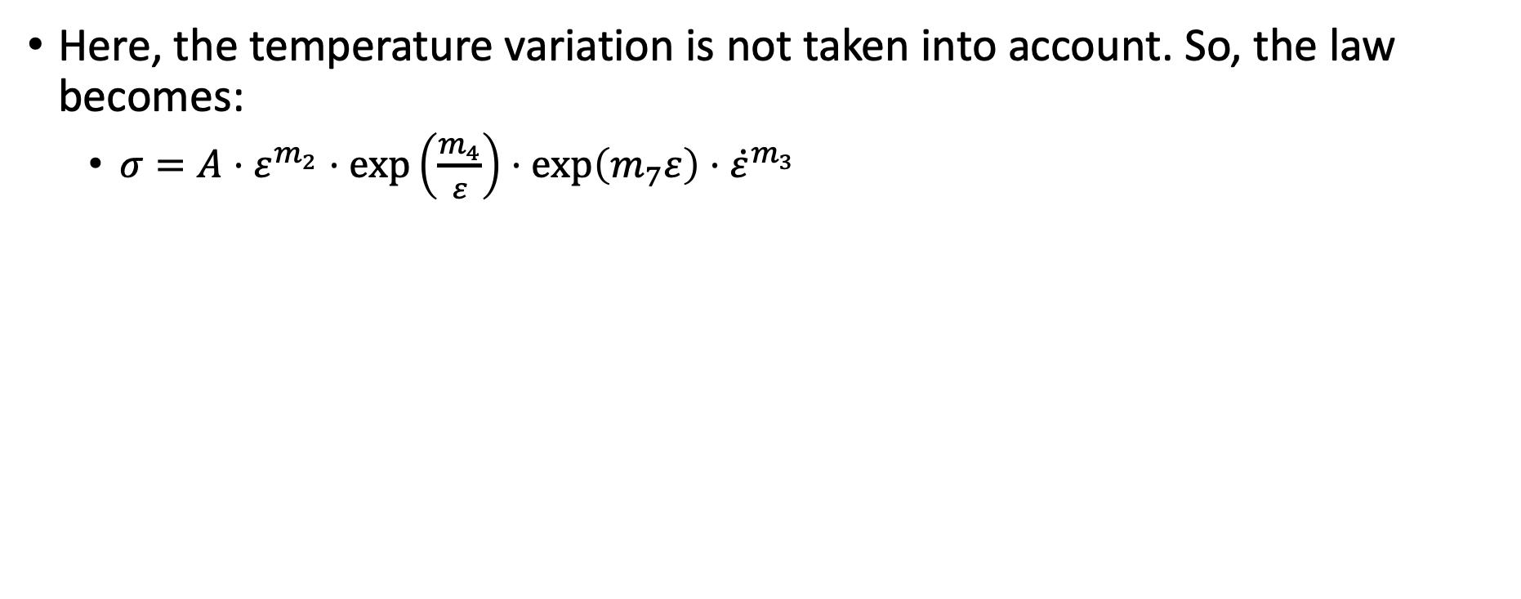
Iso-thermal
Here, the temperature variation is not taken into account. So, the law becomes:
$σ=A⋅ε^{m_{2}}⋅\exp\left(\frac{m_{4}}{ε}\right)⋅\exp\left(m_{7}ε\right)⋅{\dot{ε}}^{m_{3}}$

Slide 17
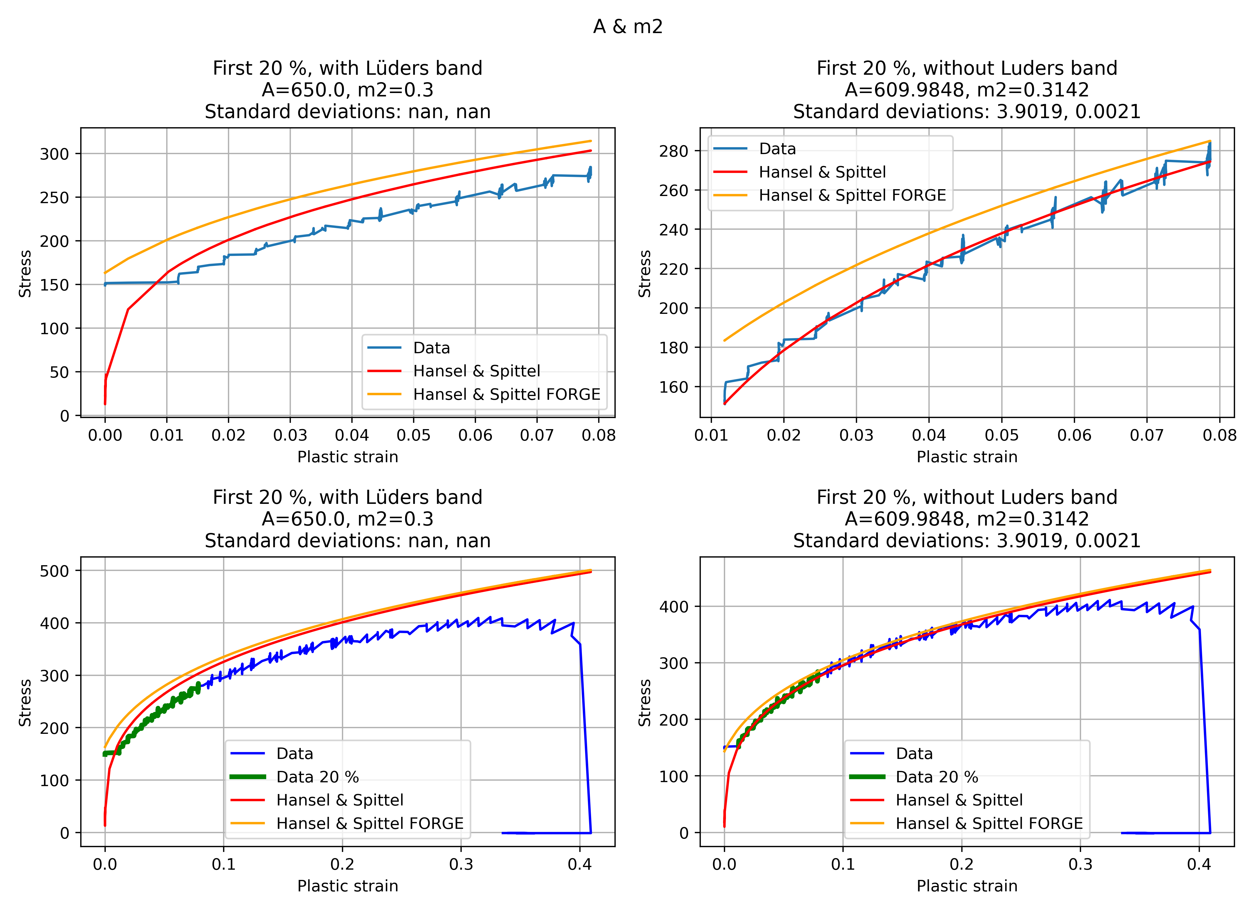
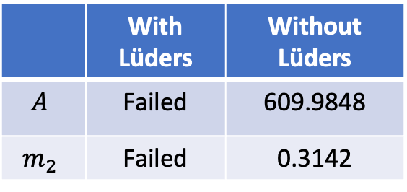
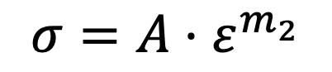
$$A,m_{2}$$
$$σ=A⋅ε^{m_{2}}$$
 | With Lüders | Without Lüders
$$A$$ | Failed | 609.9848
$$m_{2}$$ | Failed | 0.3142

Slide 18
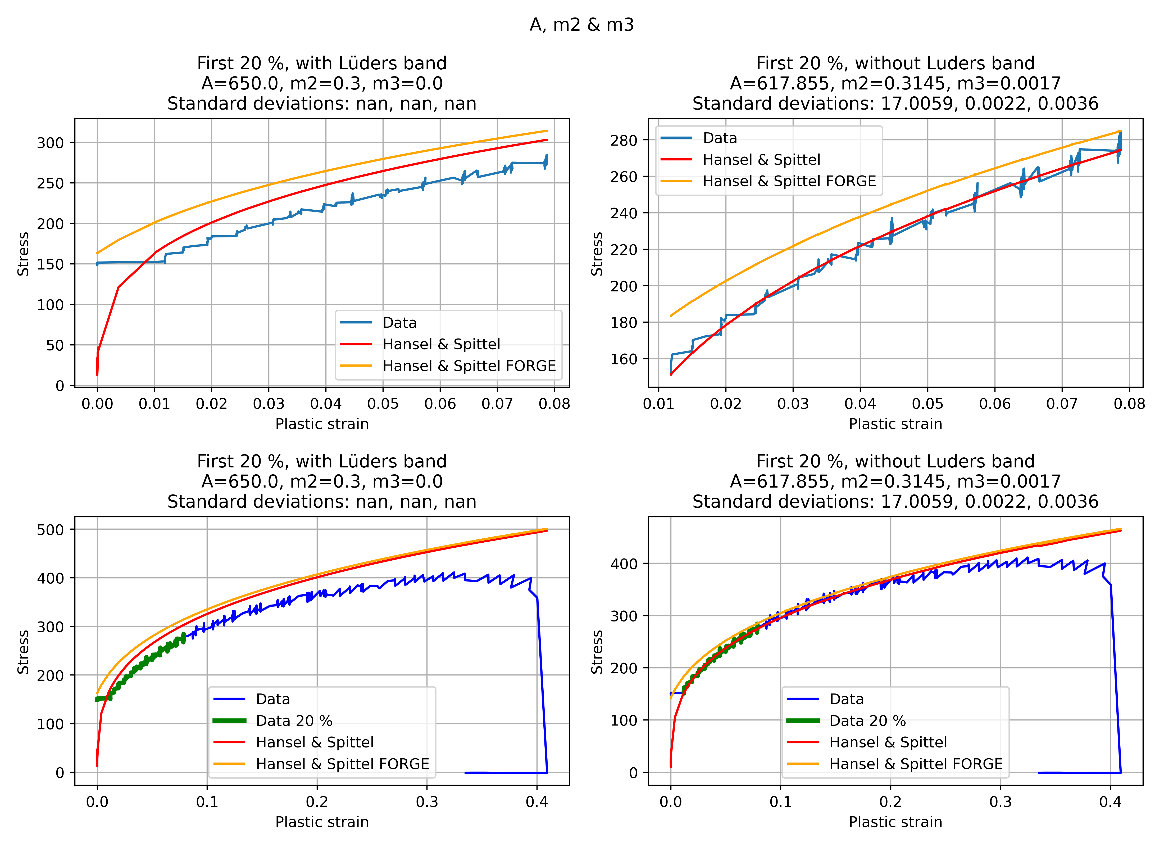
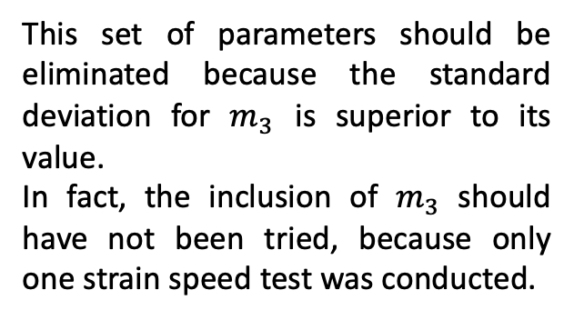
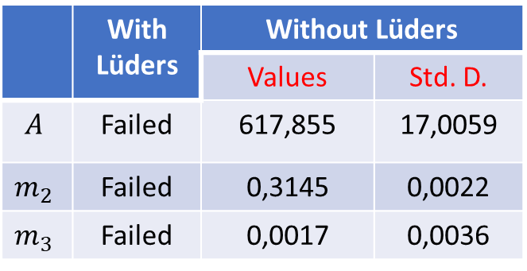
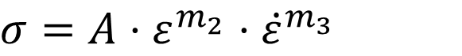
$$A,m_{2}, m_{4}$$
$$σ=A⋅ε^{m_{2}}⋅{\dot{ε}}^{m_{3}}$$
 | With Lüders | Without Lüders
 |  | Values | Std. D.
$$A$$ | Failed | 617,855 | 17,0059
$$m_{2}$$ | Failed | 0,3145 | 0,0022
$$m_{3}$$ | Failed | 0,0017 | 0,0036
This set of parameters should be eliminated because the standard deviation for $m_{3}$ is superior to its value.
In fact, the inclusion of $m_{3}$ should have not been tried, because only one strain speed test was conducted.

Slide 19
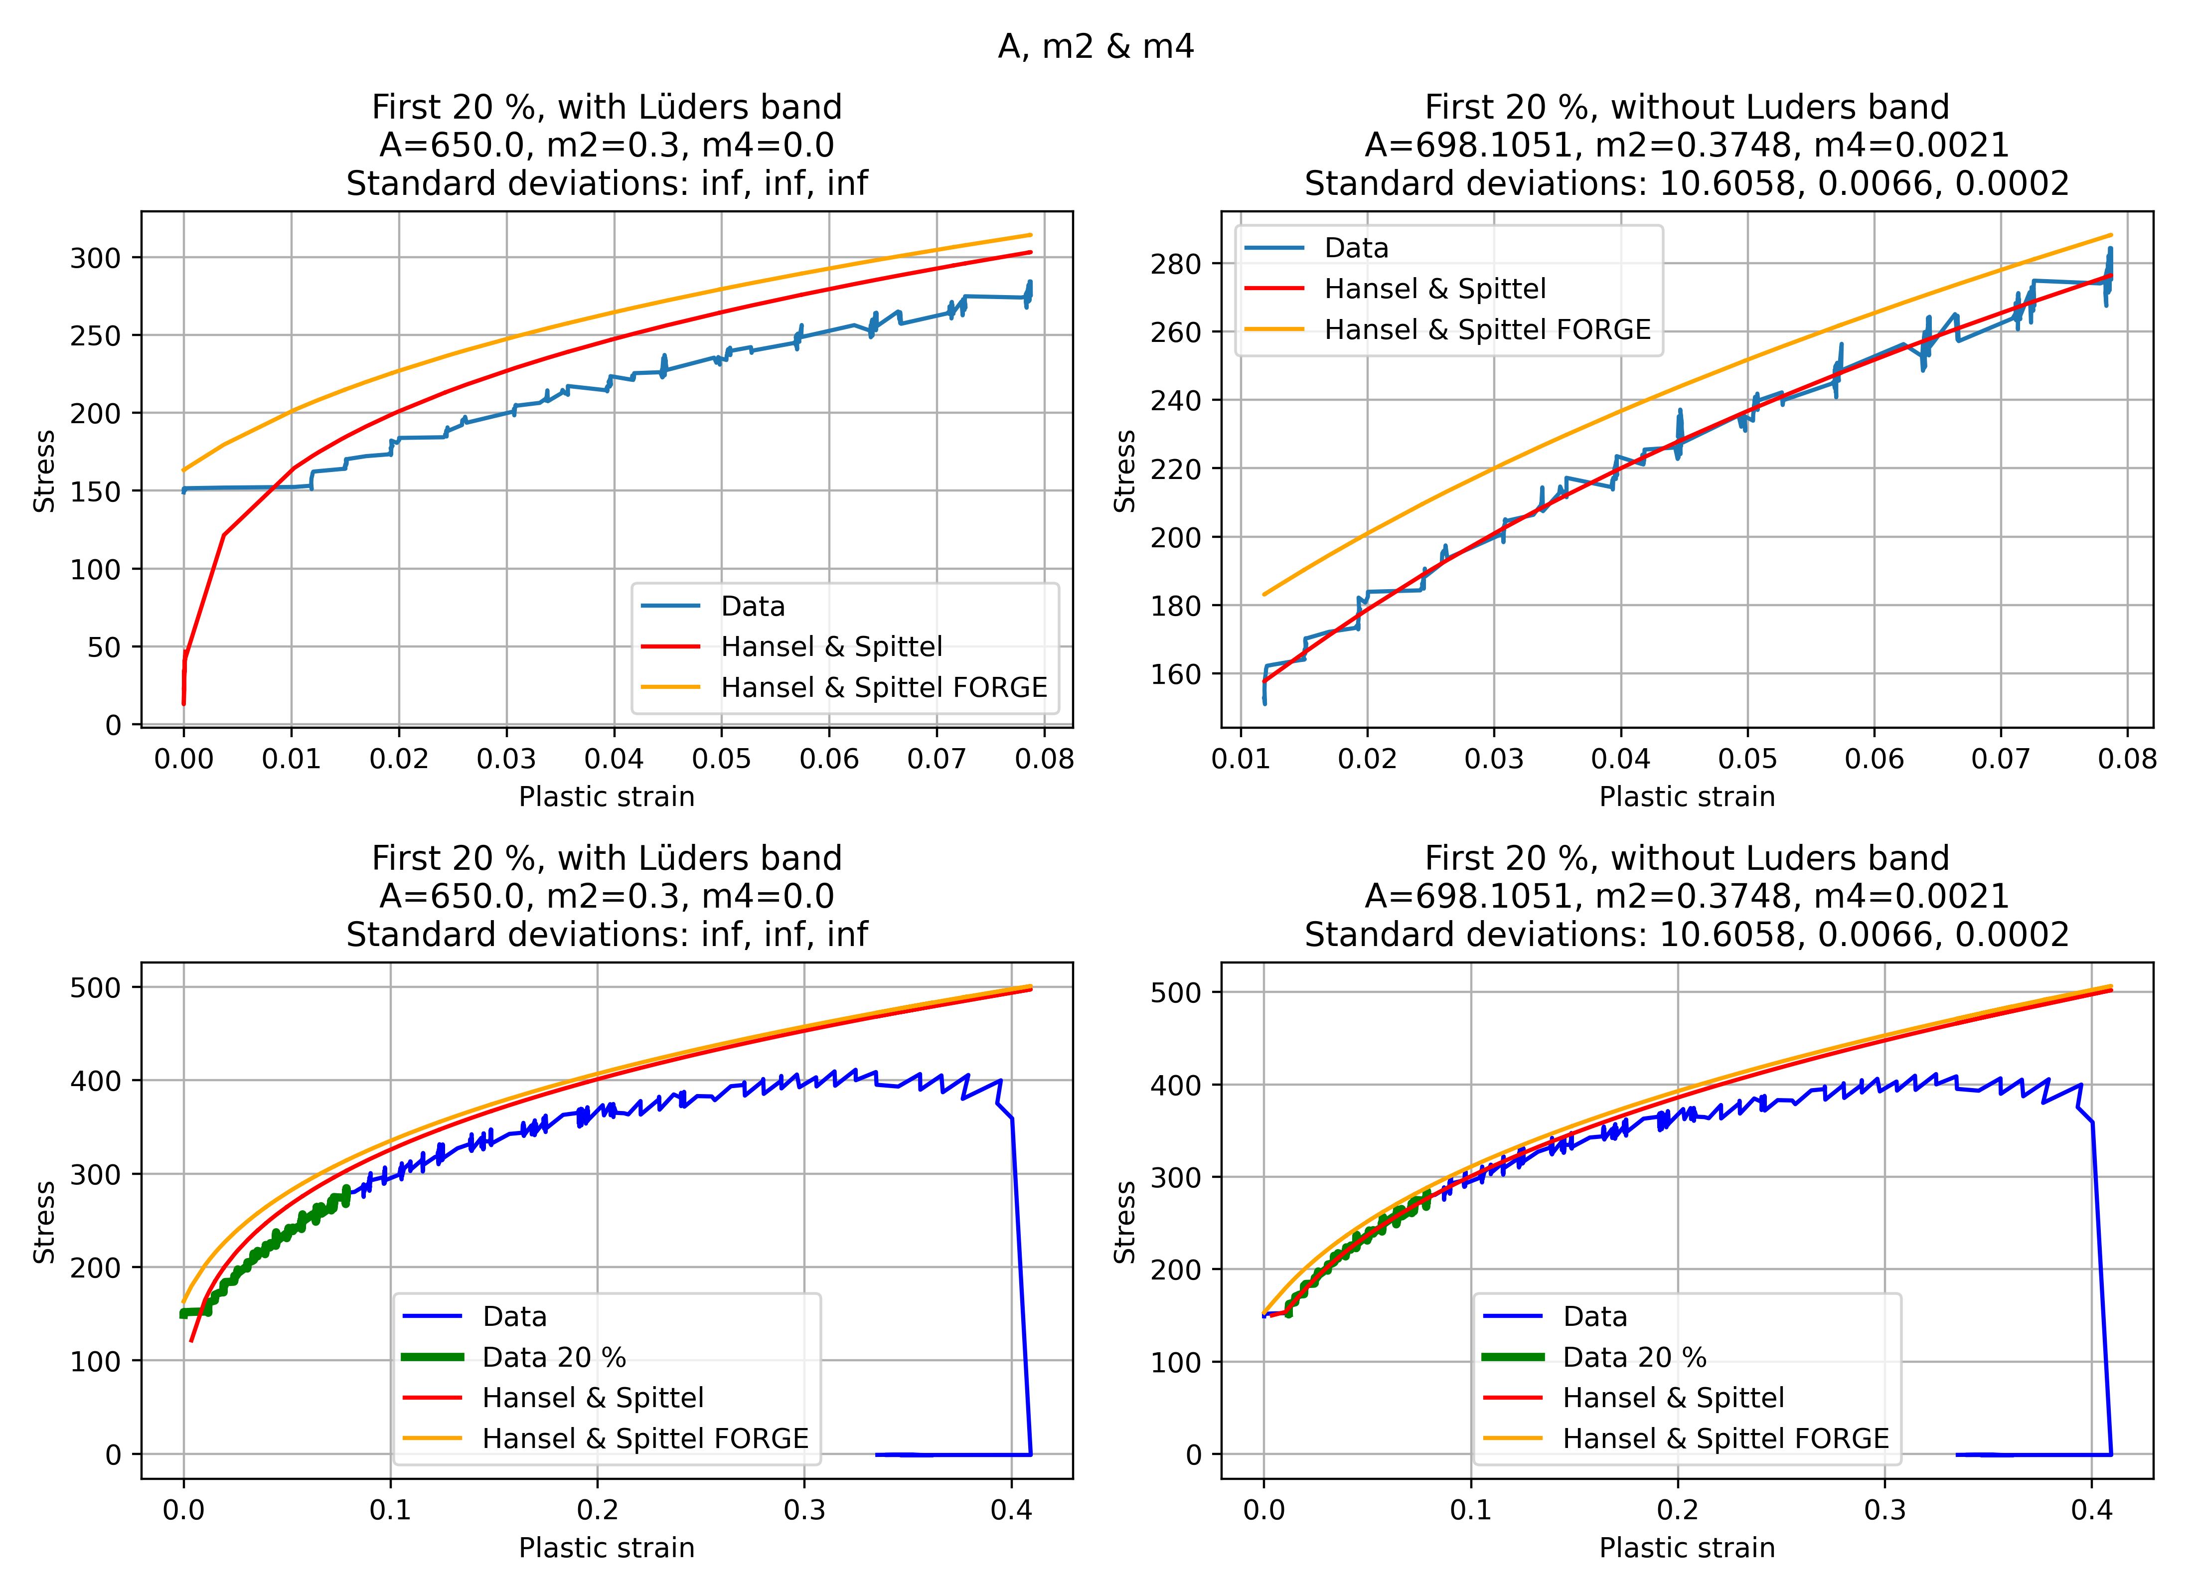
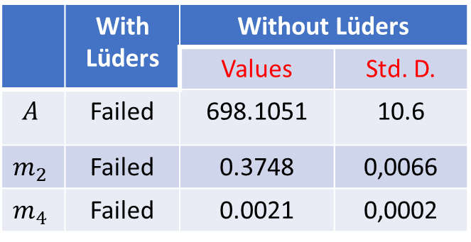
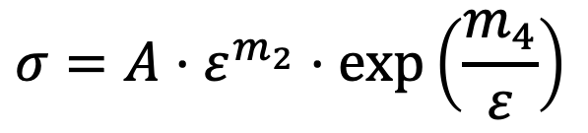
$$A,m_{2}, m_{3}$$
$$σ=A⋅ε^{m_{2}}⋅\exp\left(\frac{m_{4}}{ε}\right)$$
 | With Lüders | Without Lüders
 |  | Values | Std. D.
$$A$$ | Failed | 698.1051 | 10.6
$$m_{2}$$ | Failed | 0.3748 | 0,0066
$$m_{4}$$ | Failed | 0.0021 | 0,0002

Slide 20
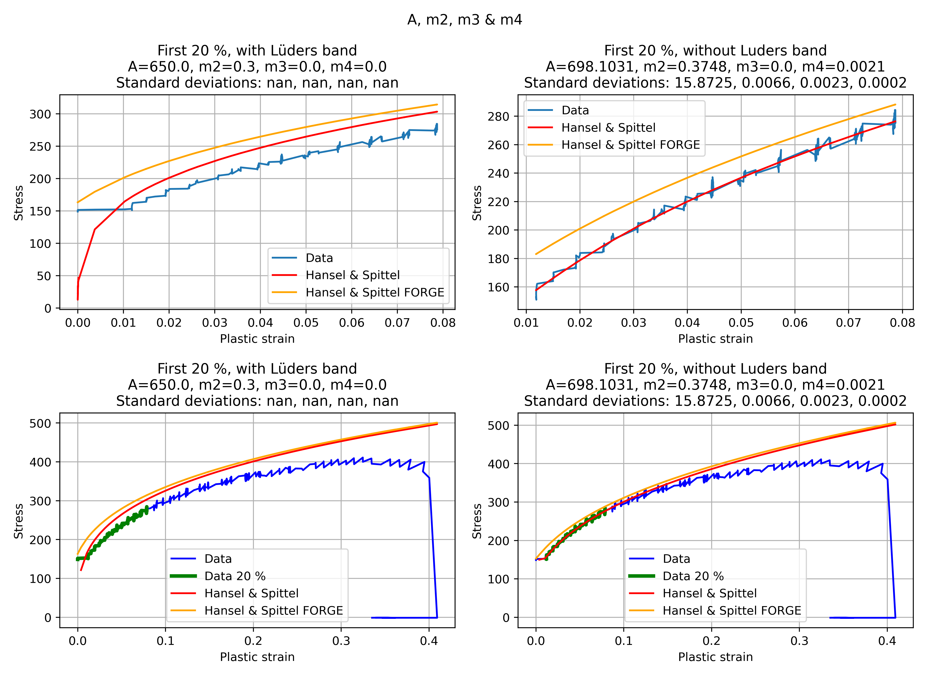
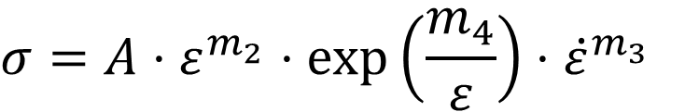
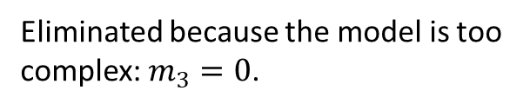
$$A,m_{2}, m_{3}, m_{4}$$
$$σ=A⋅ε^{m_{2}}⋅\exp\left(\frac{m_{4}}{ε}\right)⋅{\dot{ε}}^{m_{3}}$$
Eliminated because the model is too complex: $m_{3}=0$.

Slide 21
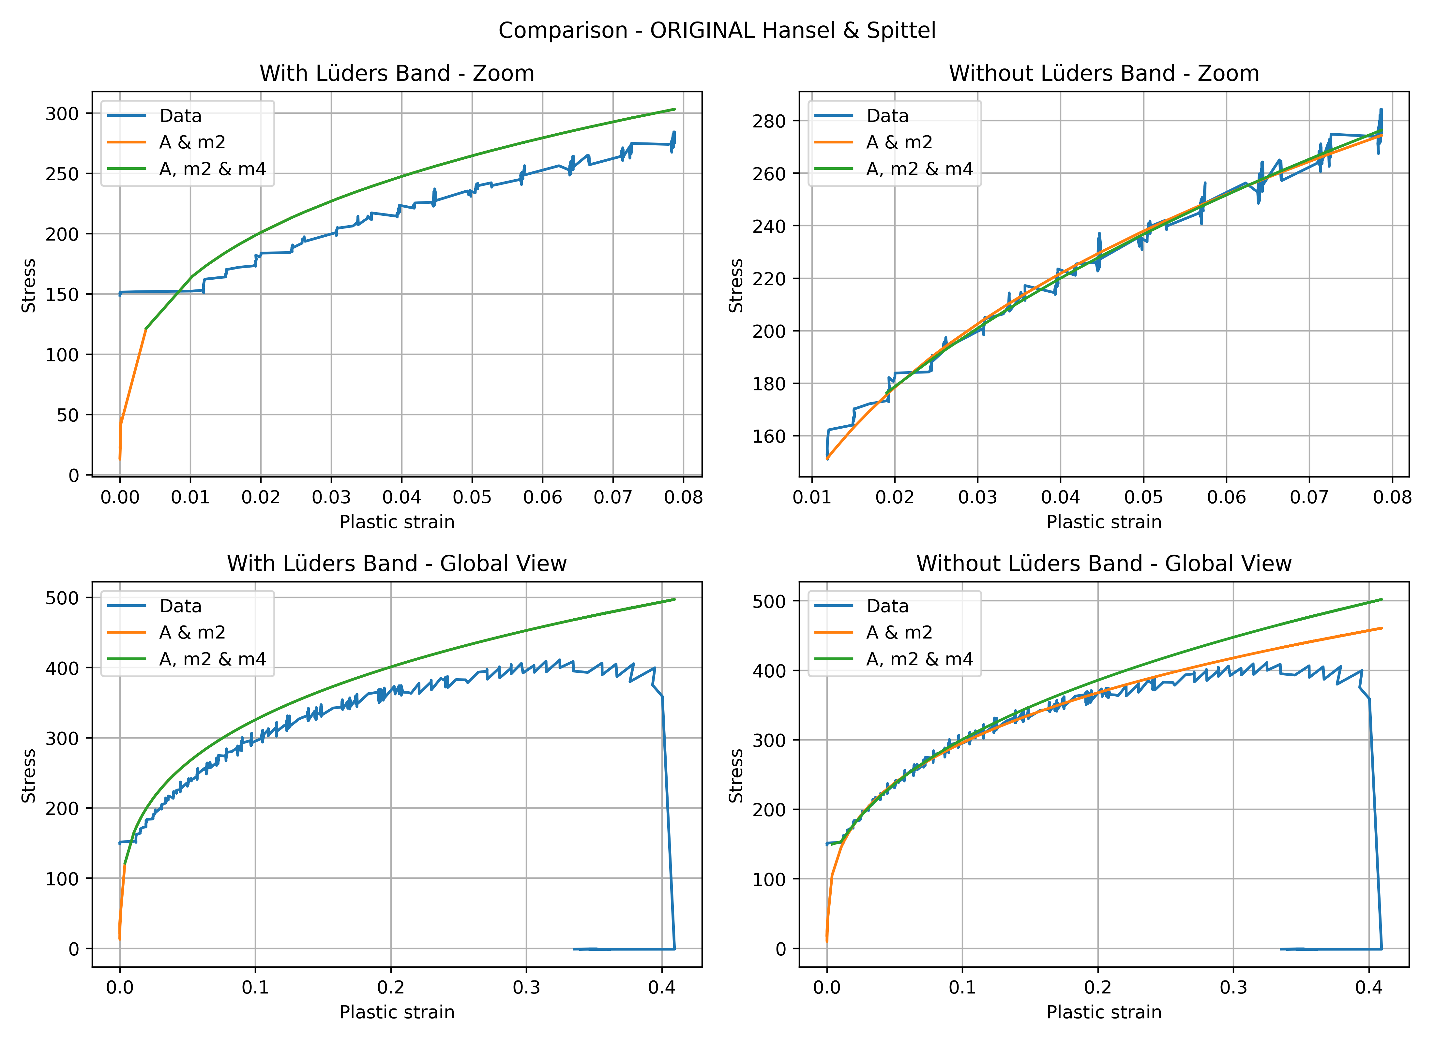
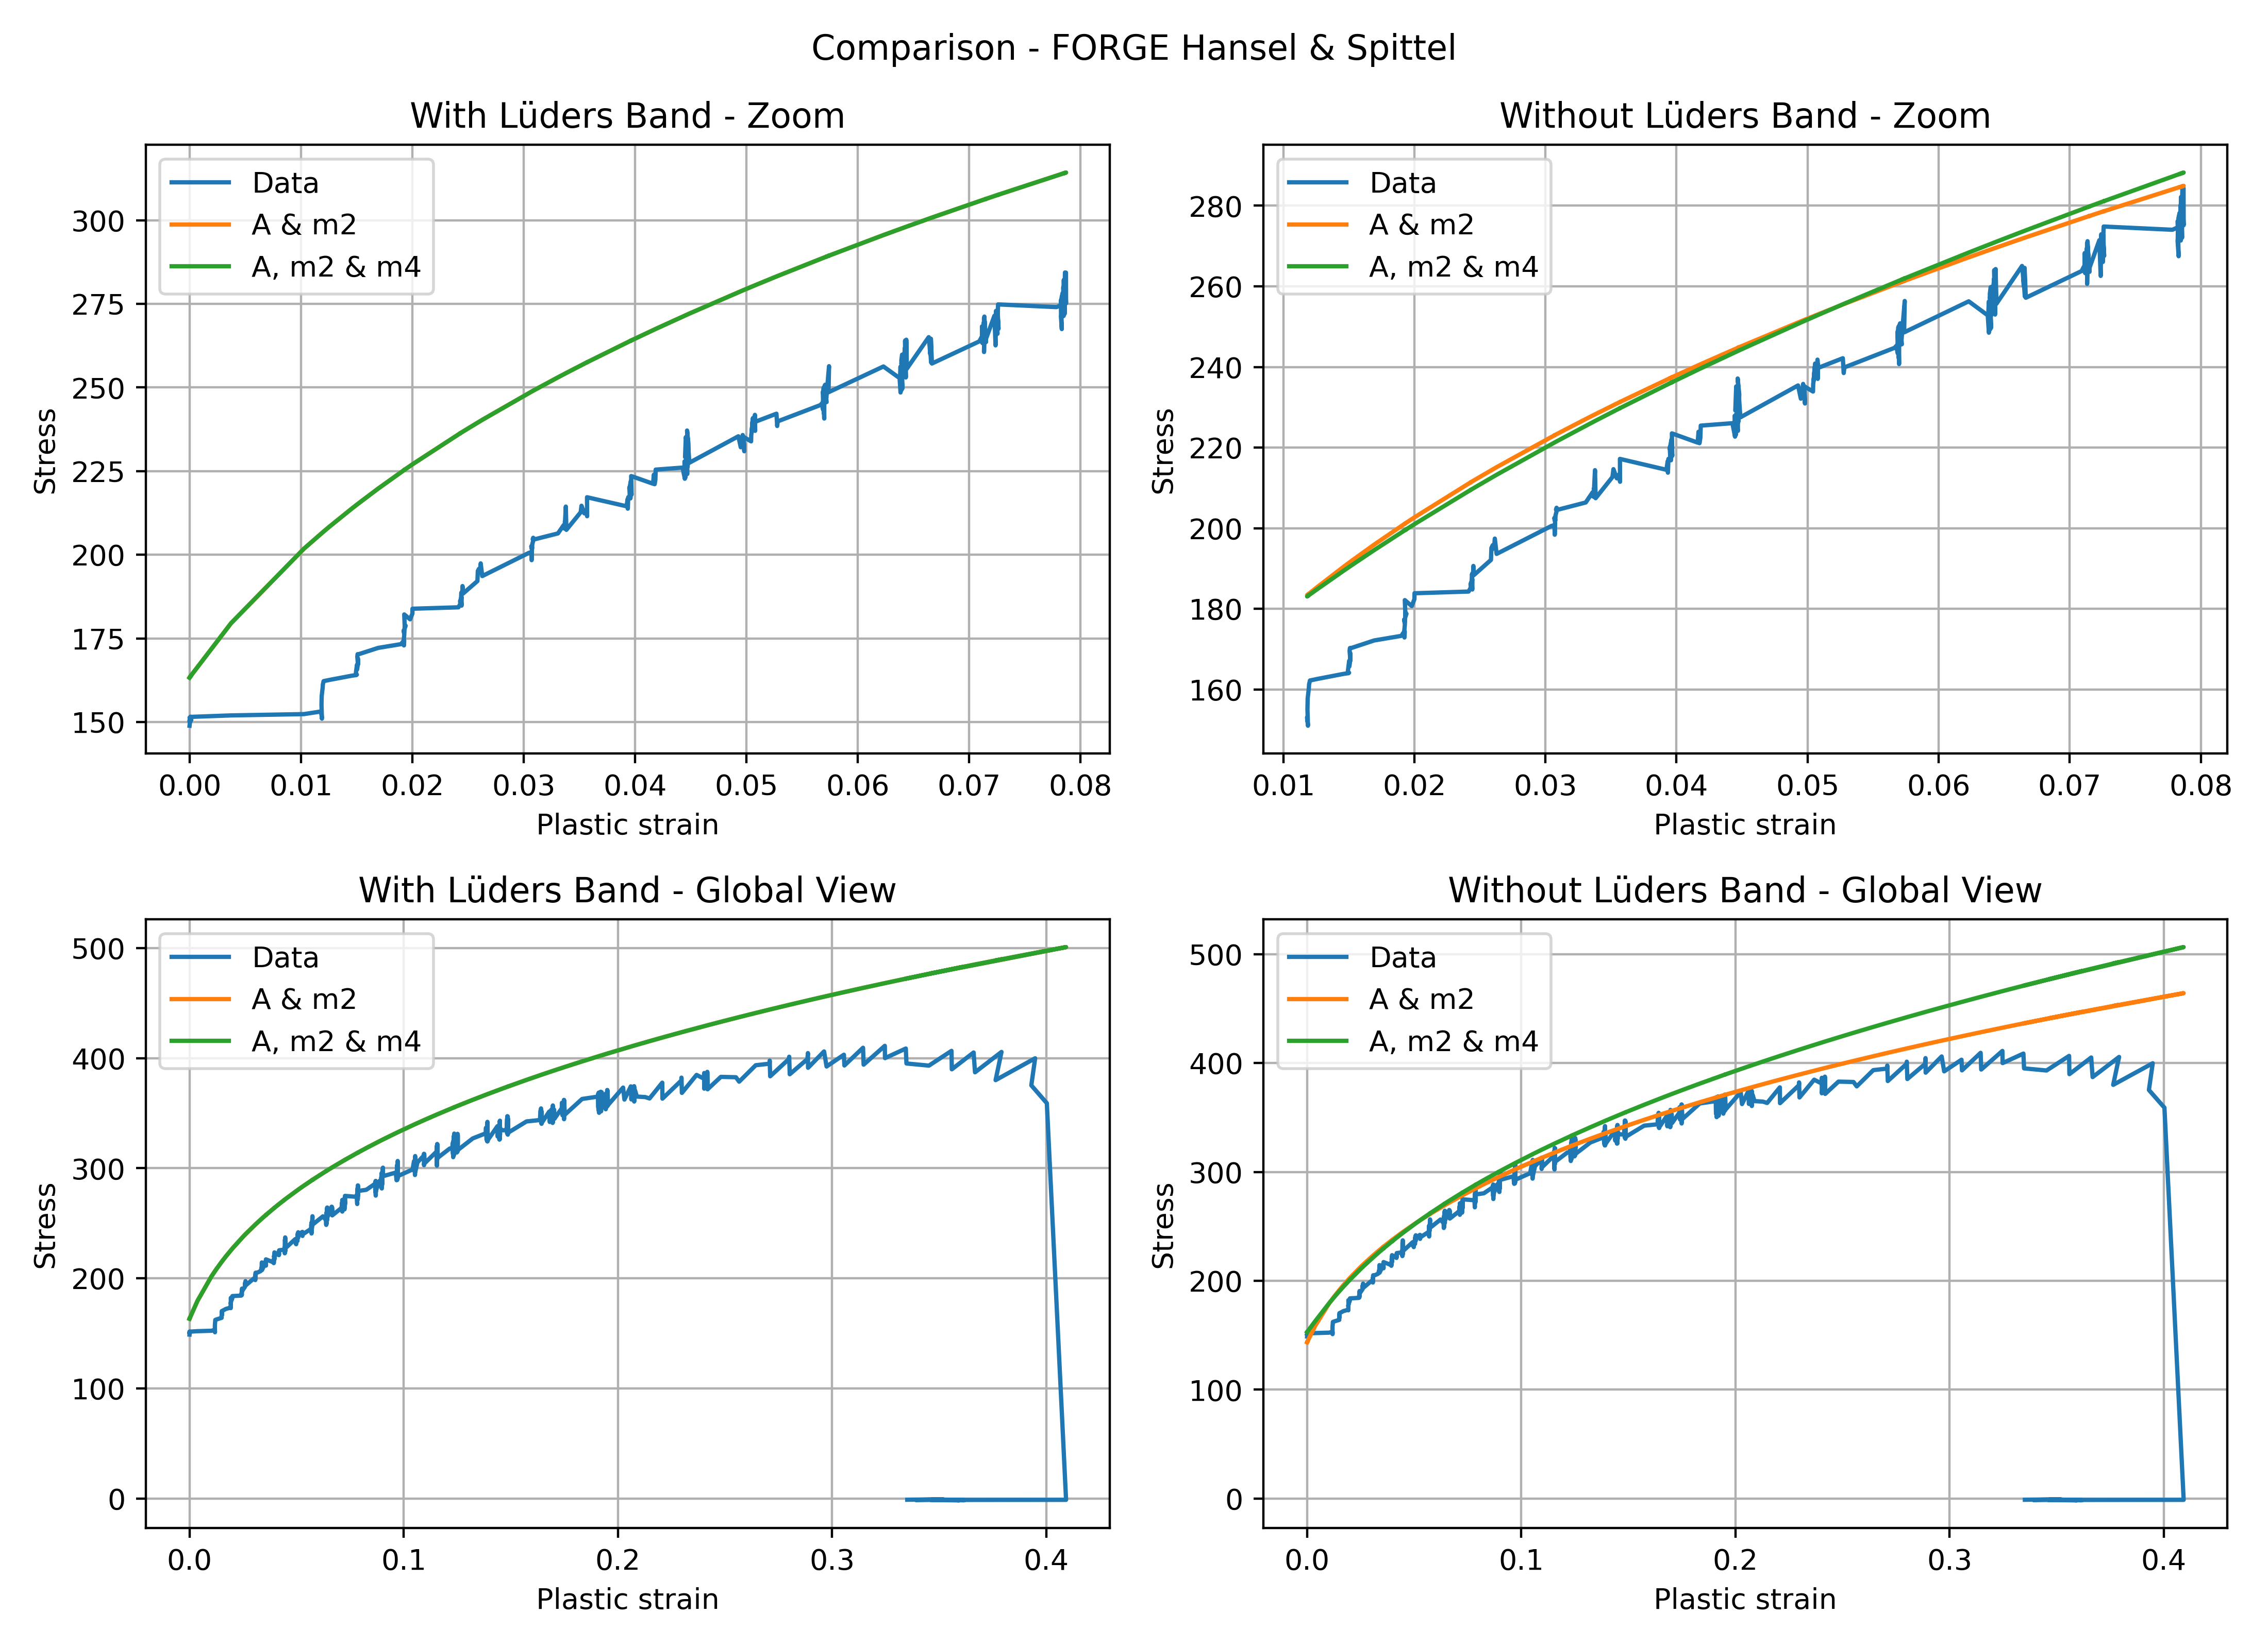
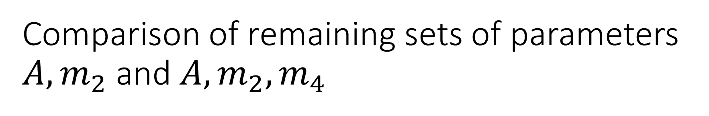
Comparison of remaining sets of parameters $A,m_{2}$ and $A,m_{2}, m_{4}$
Original H&S formulation
FORGE formulation

Slide 22
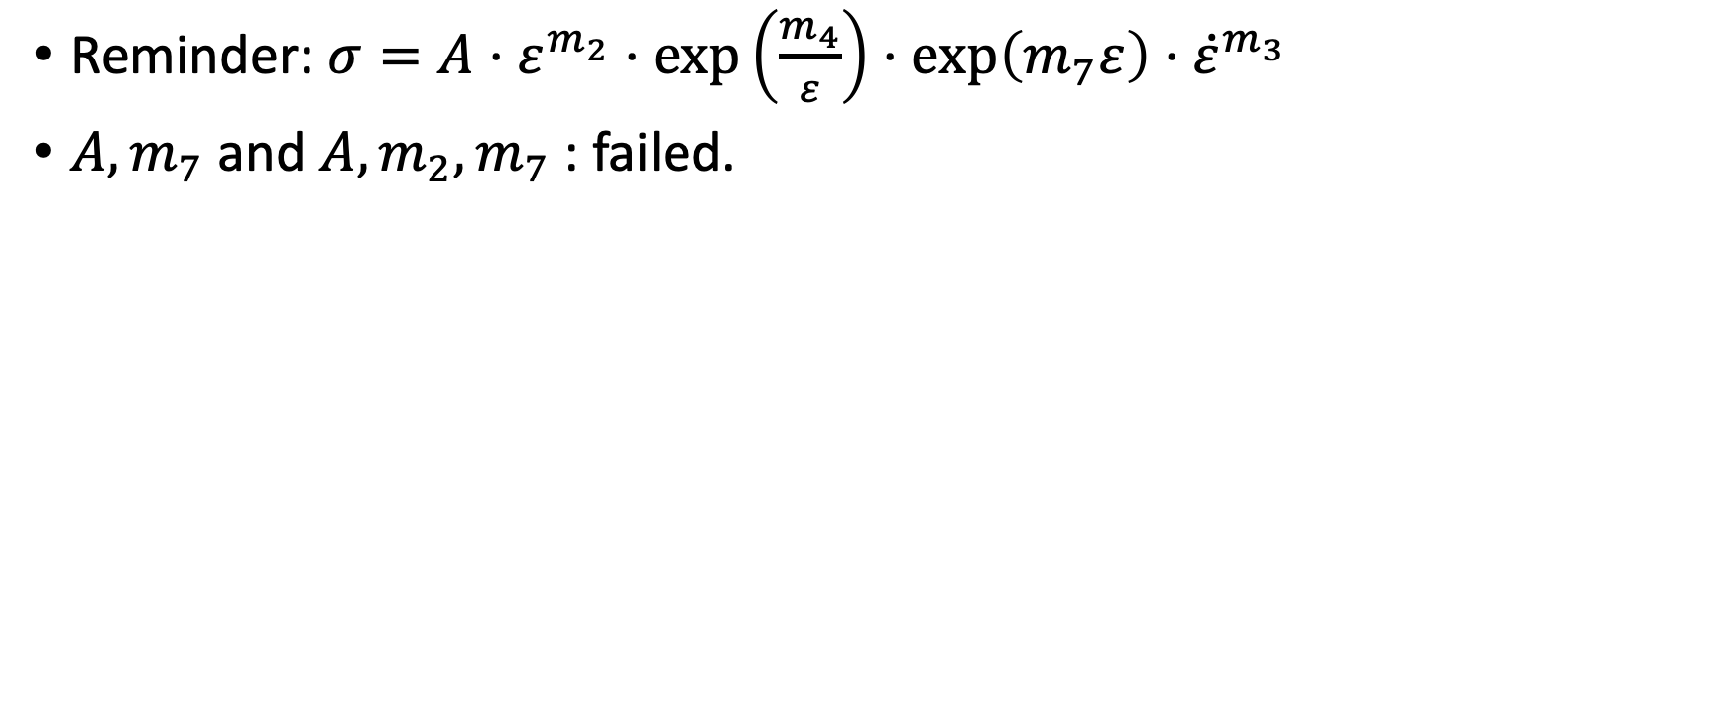
Failed configurations
Reminder: $σ=A⋅ε^{m_{2}}⋅\exp\left(\frac{m_{4}}{ε}\right)⋅\exp\left(m_{7}ε\right)⋅{\dot{ε}}^{m_{3}}$
$A, m_{7}$ and $A, {m_{2},m}_{7}$: failed.

